Slide 1
What is DataSource
Spring obtains a connection to the database through a DataSource.
A DataSource is part of the JDBC specification and is a generalized connection factory. It allows a container or a framework to hide connection pooling and transaction management issues from the application code.
As a developer, you need not know details about how to connect to the database; that is the responsibility of the administrator that sets up the datasource. You most likely fill both roles as you develop and test code, but you do not necessarily have to know how the production data source is configured.
When using Spring’s JDBC layer, you obtain a data source from JNDI or you configure your own with a connection pool implementation provided by a third party. Popular implementations are Apache Jakarta Commons DBCP and C3P0.
DB
Spring Application

Slide 2

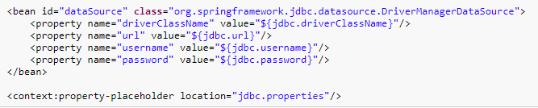
What is DataSource
You obtain a connection with DriverManagerDataSource as you typically obtain a JDBC connection. Specify the fully qualified classname of the JDBC driver so that the DriverManager can load the driver class. Next, provide a URL that varies between JDBC drivers. (Consult the documentation for your driver for the correct value.) Then provide a username and a password to connect to the database.
Only use the DriverManagerDataSource class should only be used for testing purposes since it does not provide pooling and will perform poorly when multiple requests for a connection are made.
XML Configuration

Slide 3
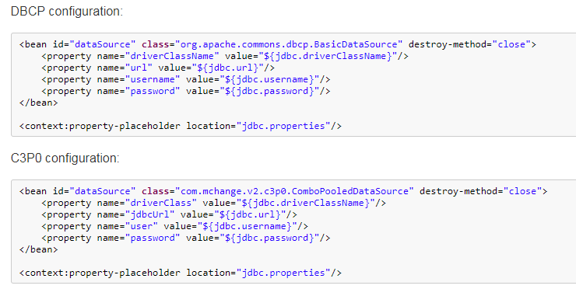
What is DataSource

